Slide 1
RoBaChine
Rolling Bamboo Machine
CREATIVITY STATION 2018

Slide 2
Table of Contents
Introduction
Background & Problem
Goals
Design & Methods
How To Use & Result
How To Maintain

Slide 3
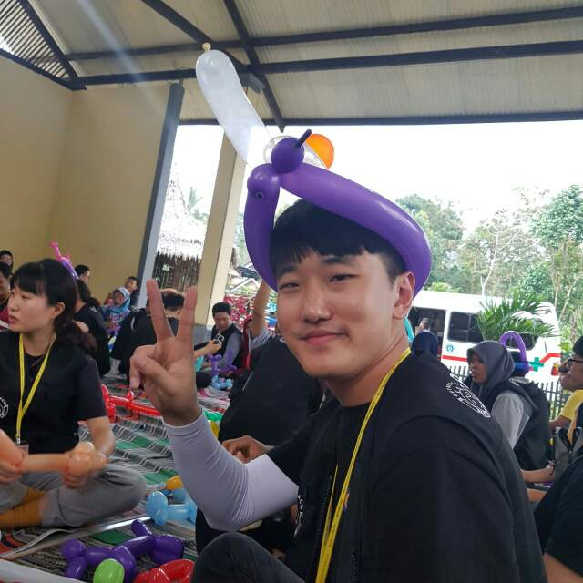
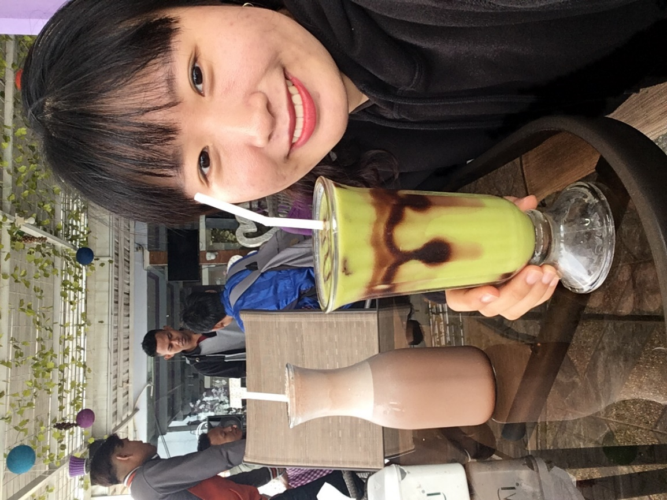

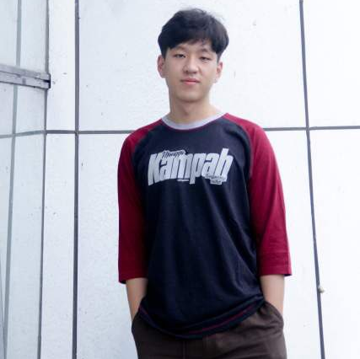


FANTASTIC SIX
Dave – Mapper
Chloe - Accountant
Abi - Scheduler
INTRODUCTION
Min - Journalist
Dilla - Communicator
Adit - Designer

Slide 4
Background
CREATIVITY STATION 2018

Slide 5
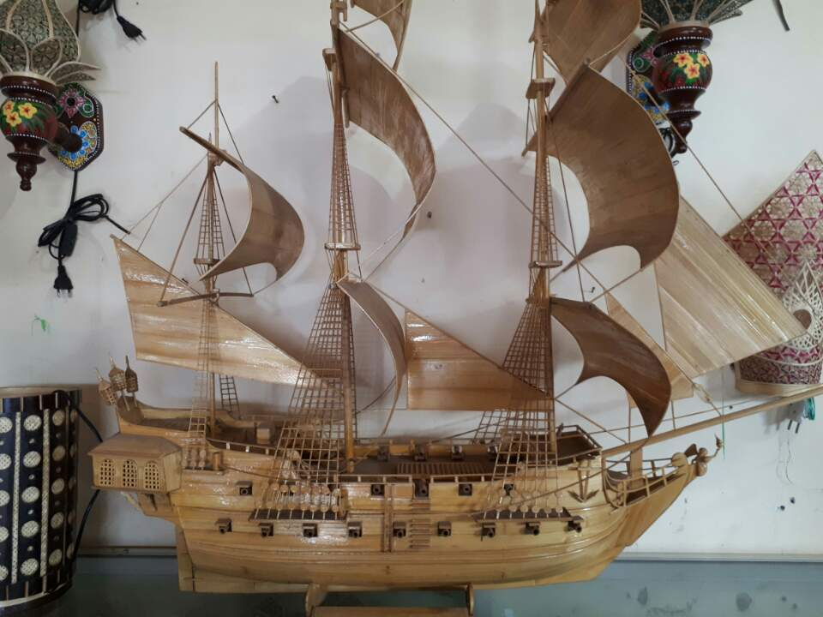
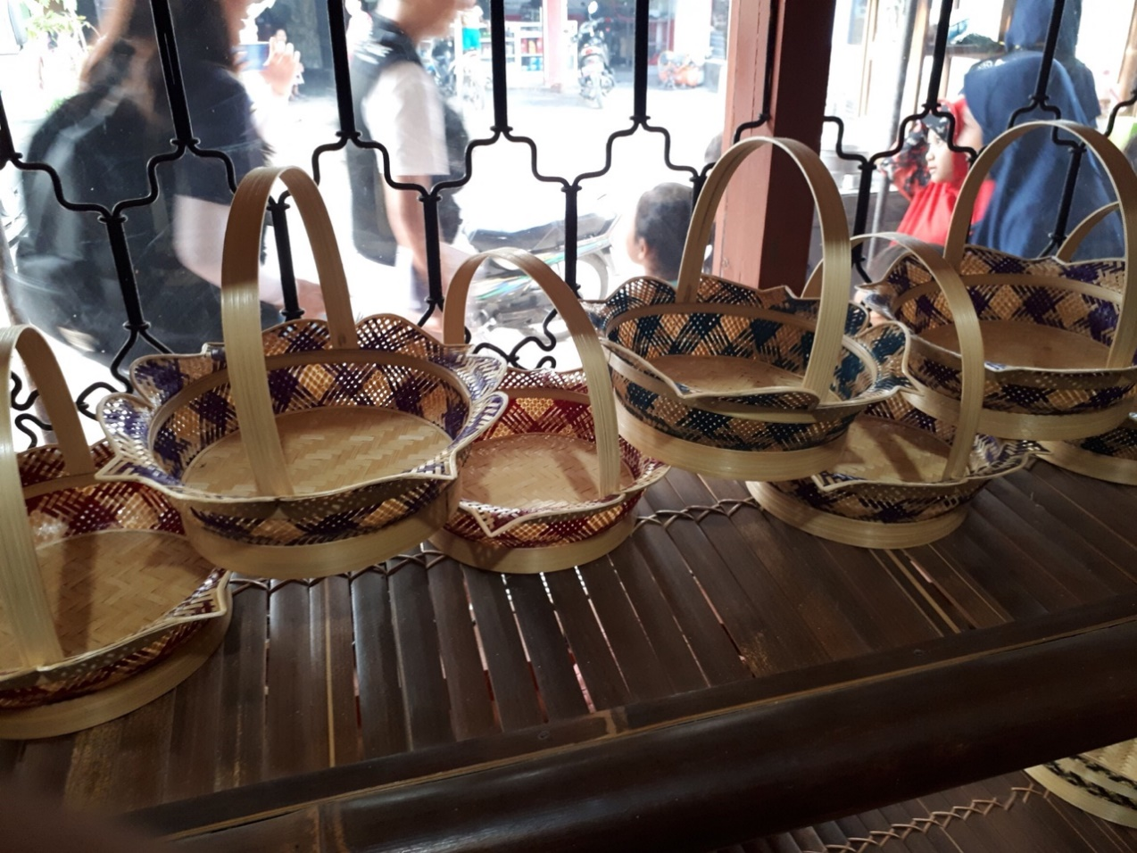
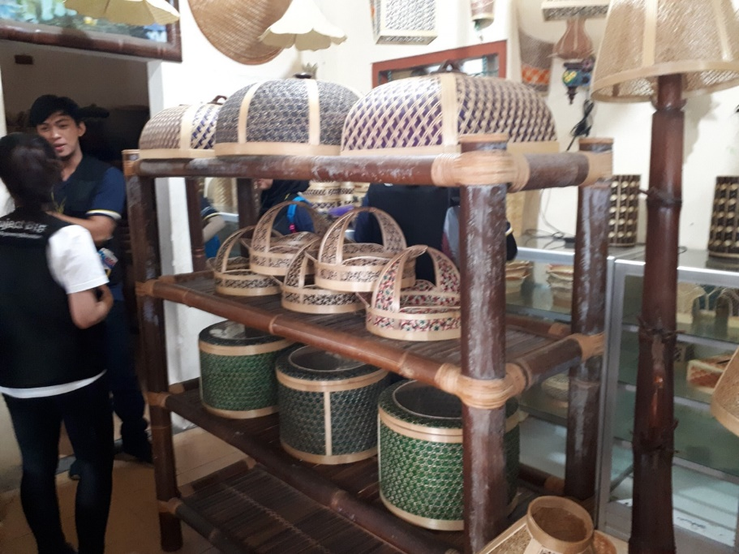
Gintangan Bamboo Crafts
What is Gintangan?
The biggest place to produce bamboo product in Banyuwangi.
Bamboo Products
They sell 200pcs bamboo product/day.
The TRUNTUM pattern is origin from Gintangan, Banyuwangi.
The most popular is the ROUNDED BAMBOO shape

Slide 6
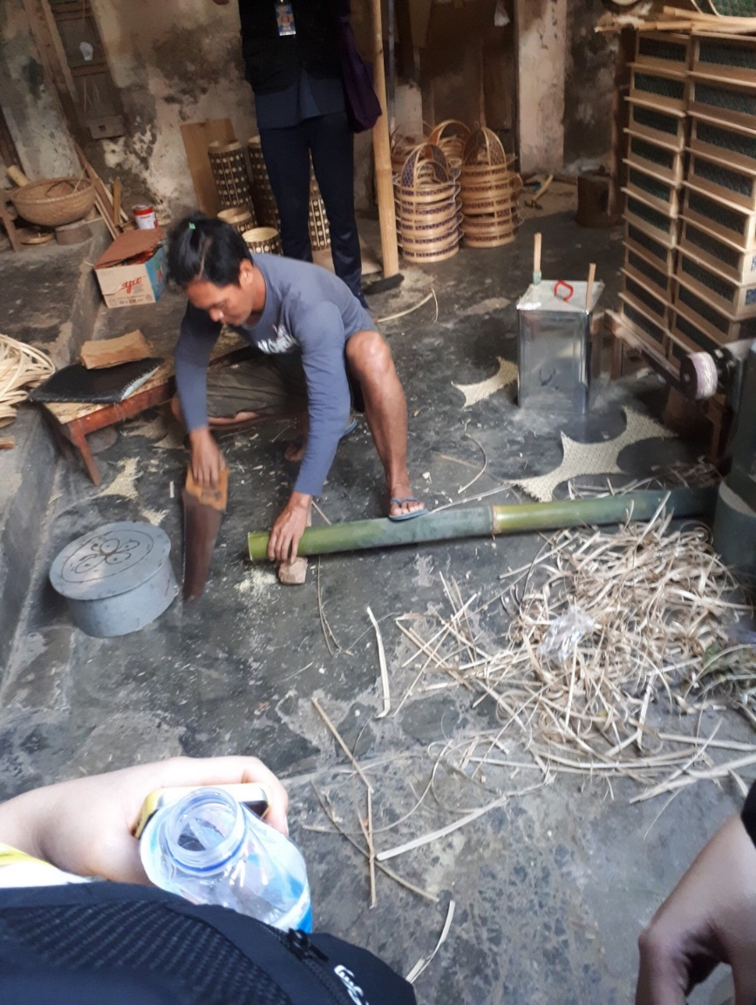
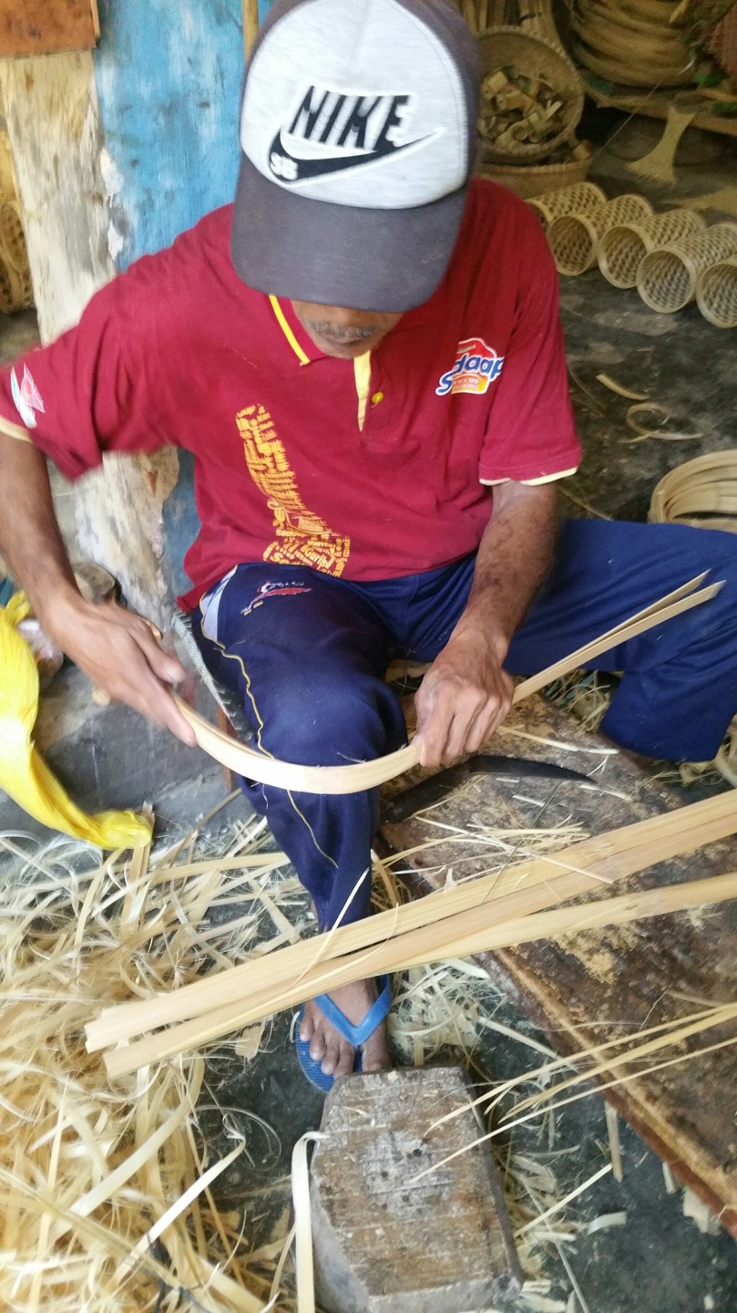
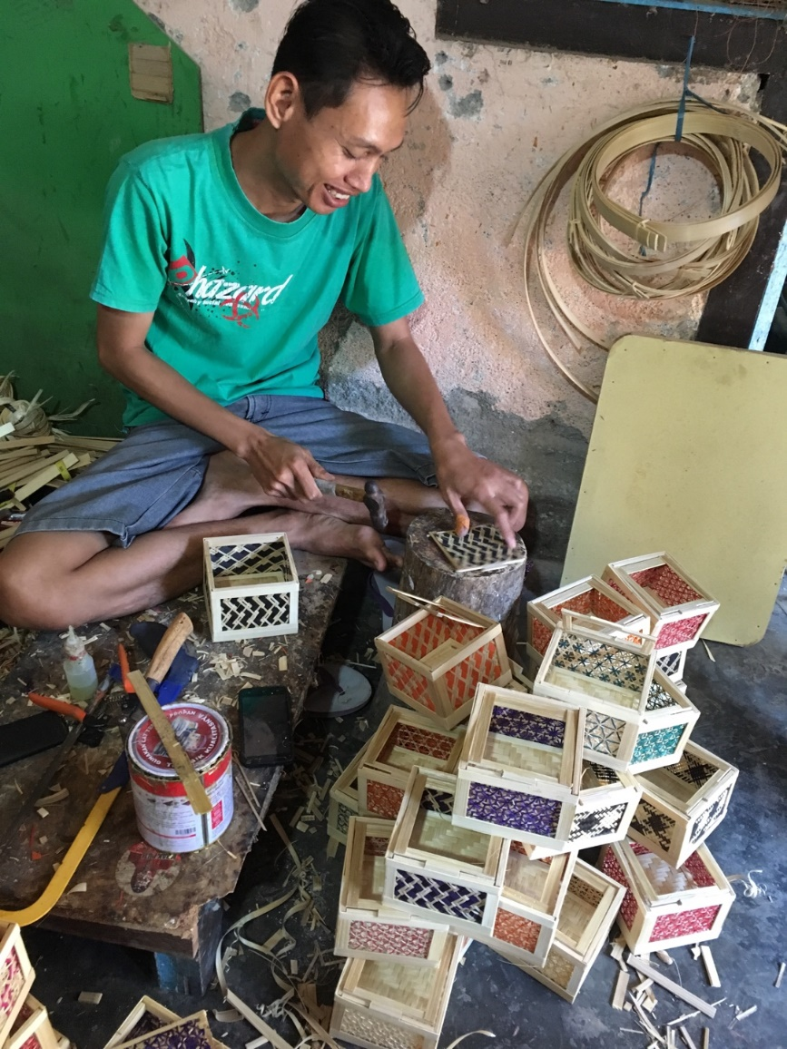

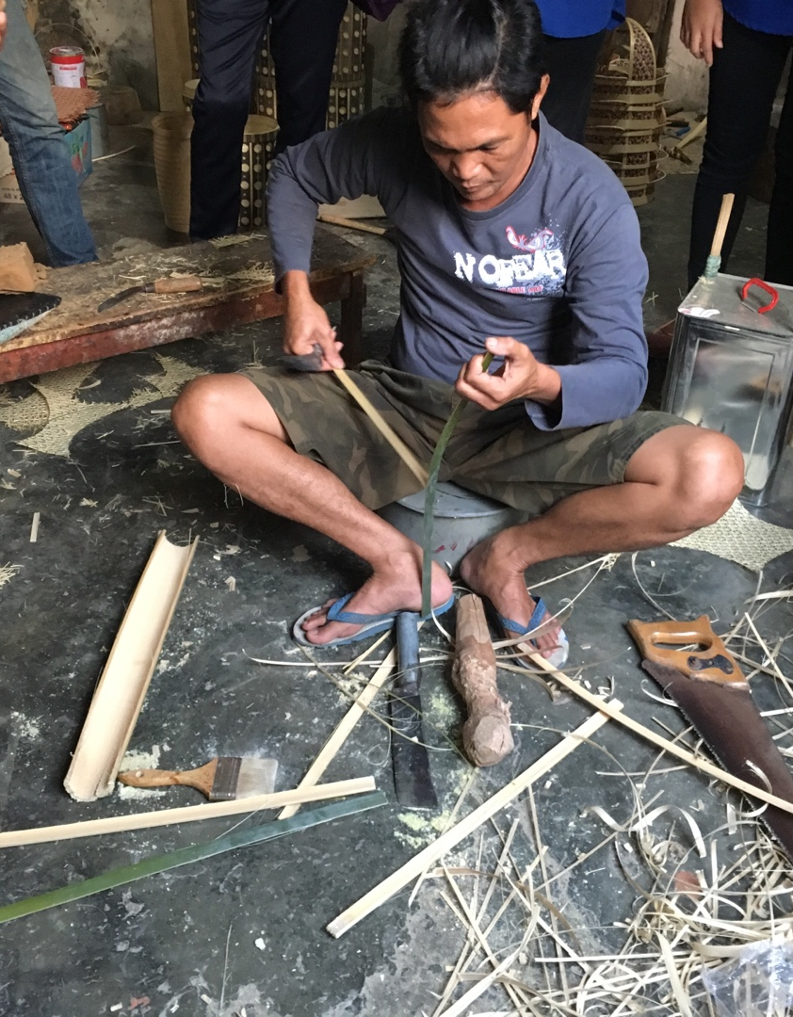
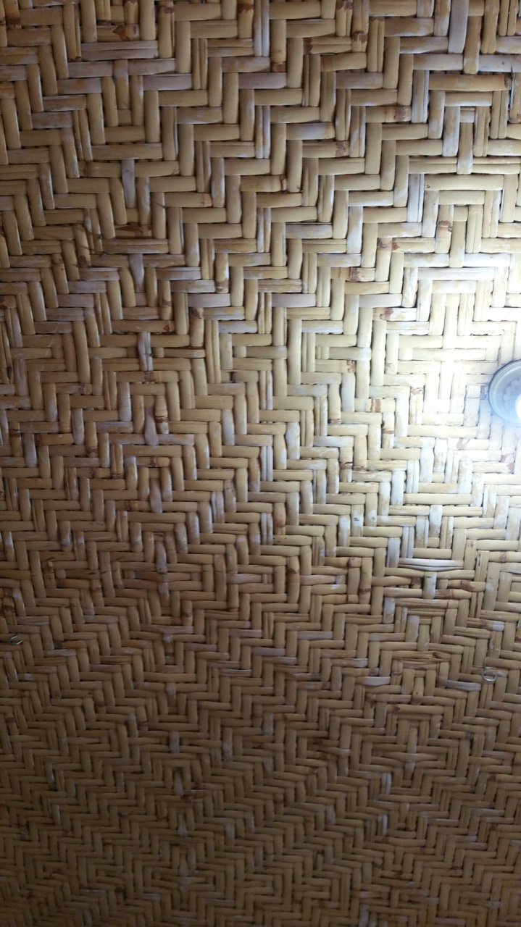
Thinner the bamboo
Thread the bamboo
Cut the Bamboo into pieces
Bend the bamboo
Assemble all the bamboo parts

Slide 7
Problem
CREATIVITY STATION 2018

Slide 8
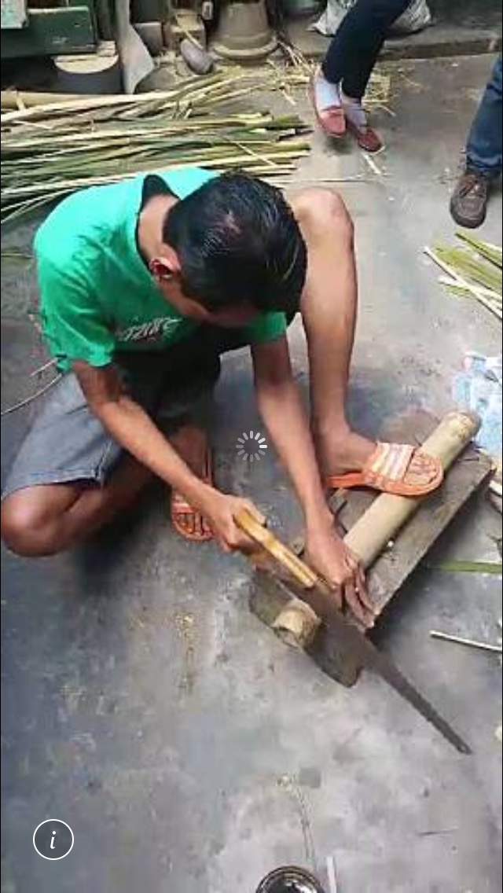

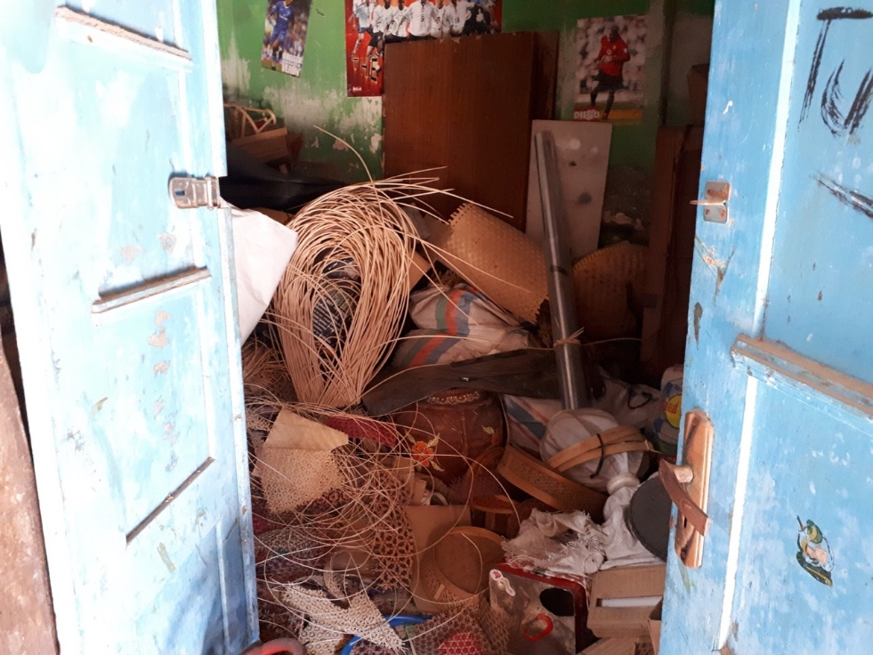
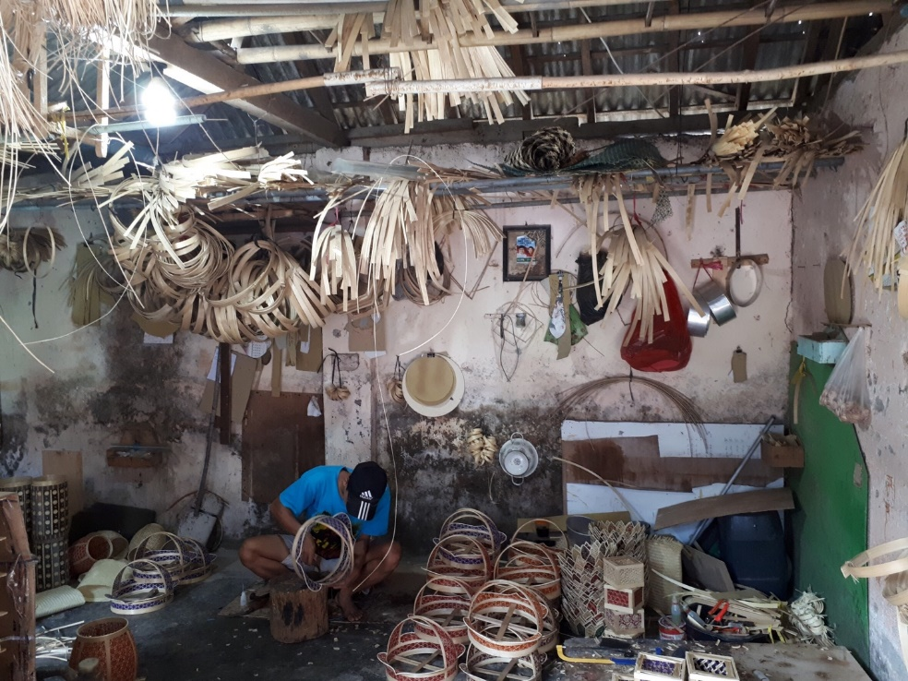
The most popular issues
Top 4 issues in Gintangan Bamboo Craft.
Unsafety bamboo holder
Manual way to bend the bamboo
The messy place
No free space
The bamboo holder is too dangerous because the bamboo can easily move when they cut the bamboo.
The bamboo artisans use his knee to bend the bamboo, it may hurt his knee.
The bamboo artisans put their tools randomly, it may hurts the barefoot.
The rounded bamboos are hanging on the roof, it may break the bamboo in rainy season.

Slide 9
CHOSEN ISSUE “Manual way to bend the bamboo”

Slide 10
4 Ideas for this issue
1
Column
Make a fixed column from the iron tube.
2
Frame
Put the bamboo into the frame.
3
Roller Machine
Bend the bamboo with metal-tube to squeeze and thinning the bamboo.
4
Nails bending
Use nail to pull out the bamboo.
Notes:
Urgency repetition simplicity get a high score

Slide 11
CHOSEN IDEA “Roller Machine”

Slide 12
Goals
CREATIVITY STATION 2018

Slide 13
Our Goals
3 Important Keywords
Quality
Everyone can bend the bamboo with the same quality.
Cost
They don’t need to pay much to the worker to bend the bamboo, so it is more cheaper.
Speed
The bamboo artisan can make a rounded shape of bamboo faster.

Slide 14
If they can reach the goals, they can increase their money income.

Slide 15
Design
CREATIVITY STATION 2018

Slide 16
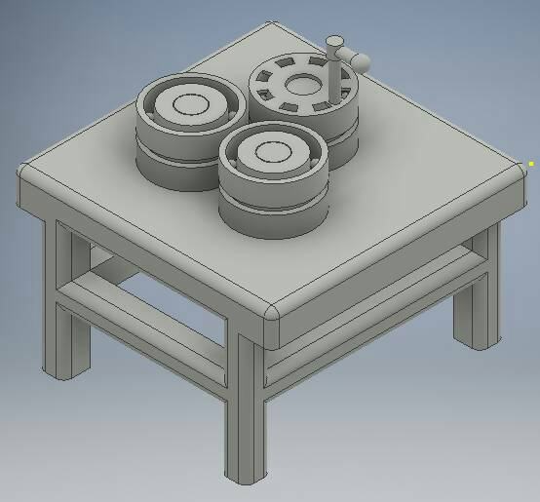
Roller Machine (design)

Slide 17
Materials
Bearings (6pcs)
Steel Plate (45 cm x 50 cm)
Hollow Steel (4.5cm x 4.5cm)
Lever
Shaft
Steel Paint
Thinner
Grinder Plate (5 pcs)
Electrode (1 box)

Slide 18
Tools
Grinder
Welding Machine
Ruler
Paint brush

Slide 19
Method
CREATIVITY STATION 2018

Slide 20
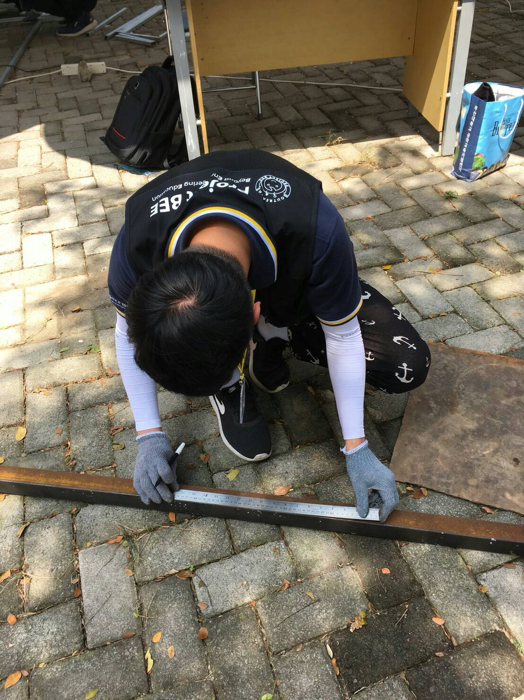
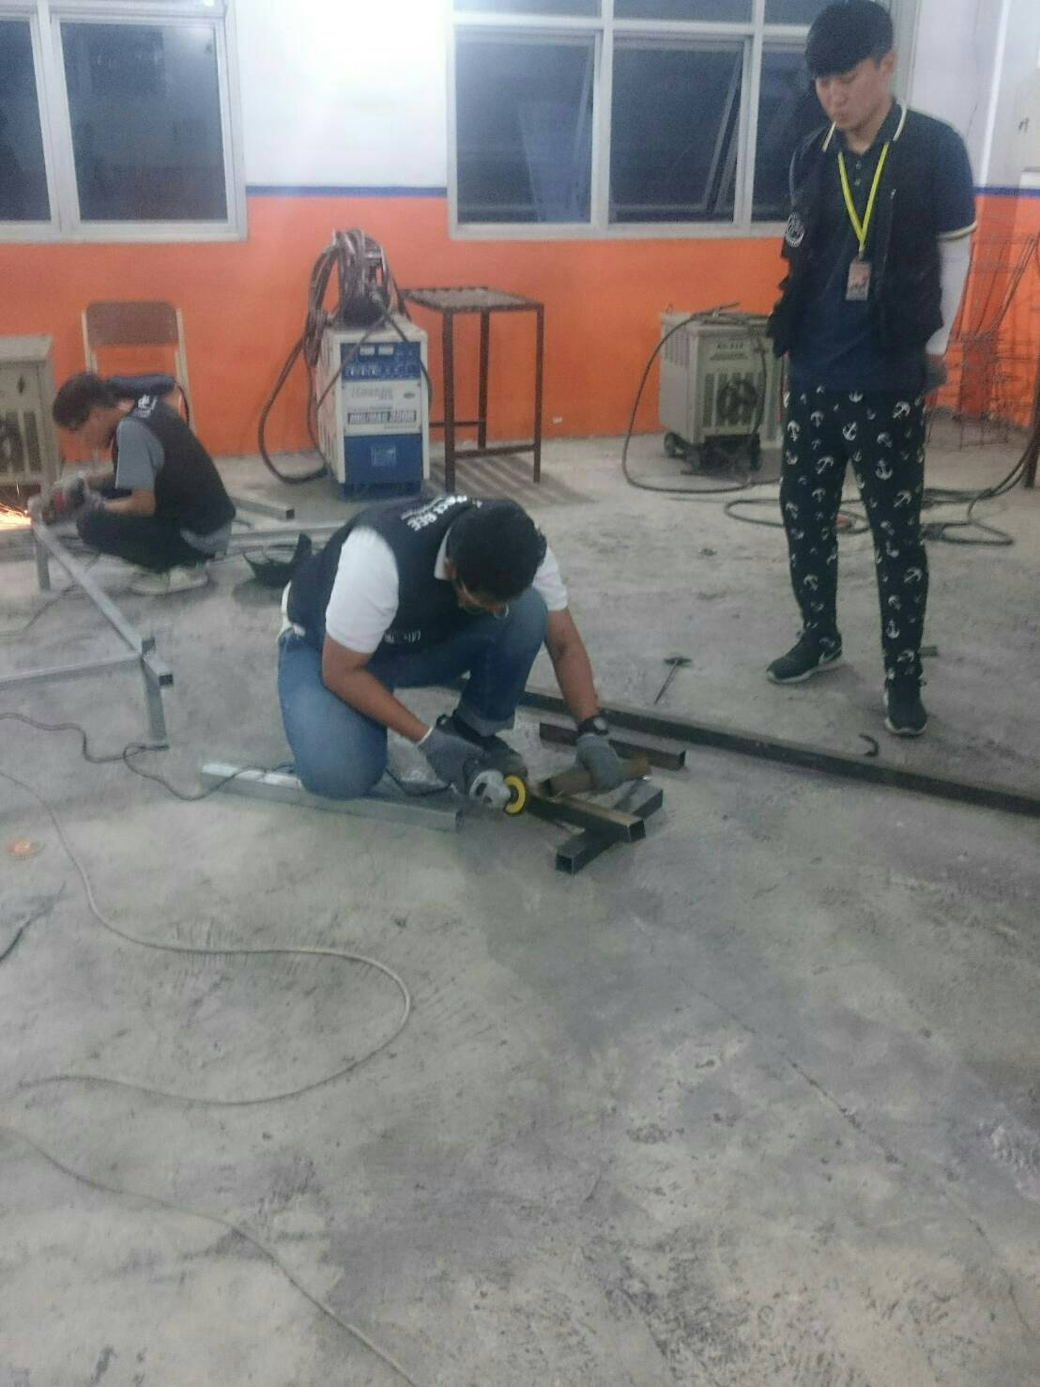
Steps
2nd step
1st step
Measure the length of the hollow steel that will be cut.
Cut the hollow steel based on the measurement we have done before.

Slide 21
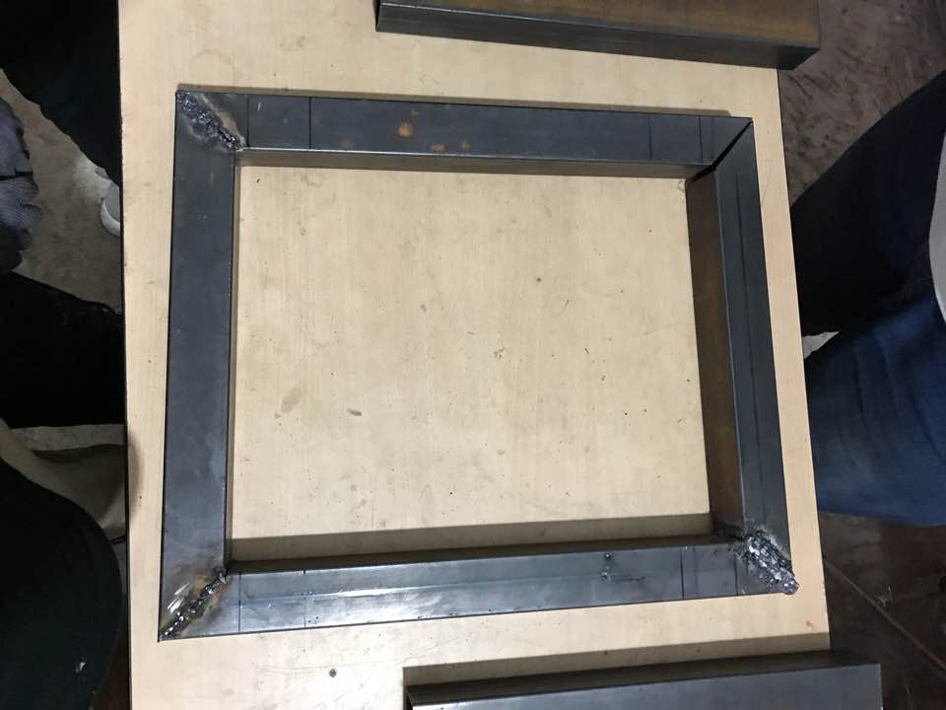
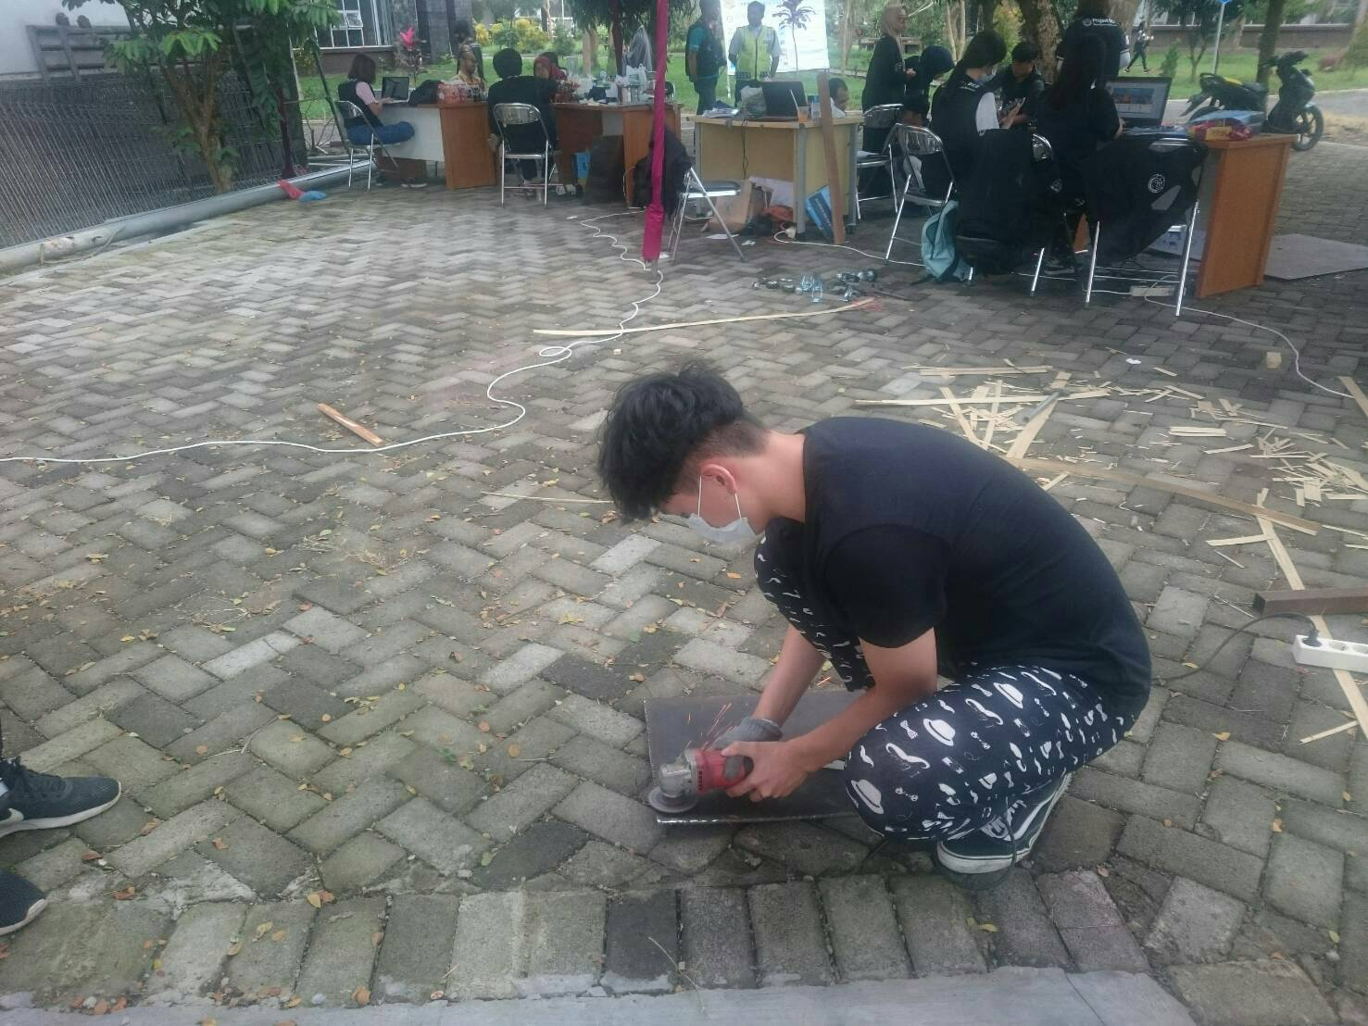
Steps
4th step
3rd step
Weld all the hollow steel to make it as a frame.
Cut the steel plate.

Slide 22
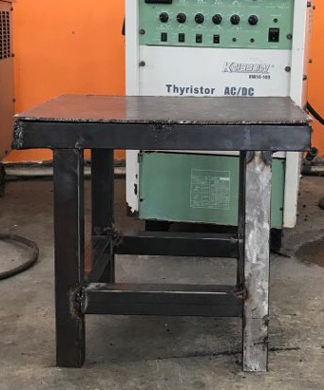
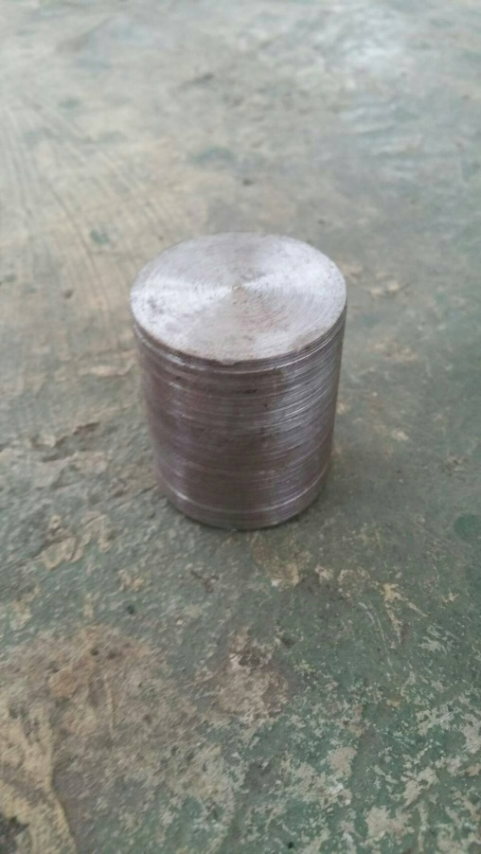
6th step
5th Step
Weld the whole frame to the steel plate.
Cut the shaft as high as the bearings.

Slide 23
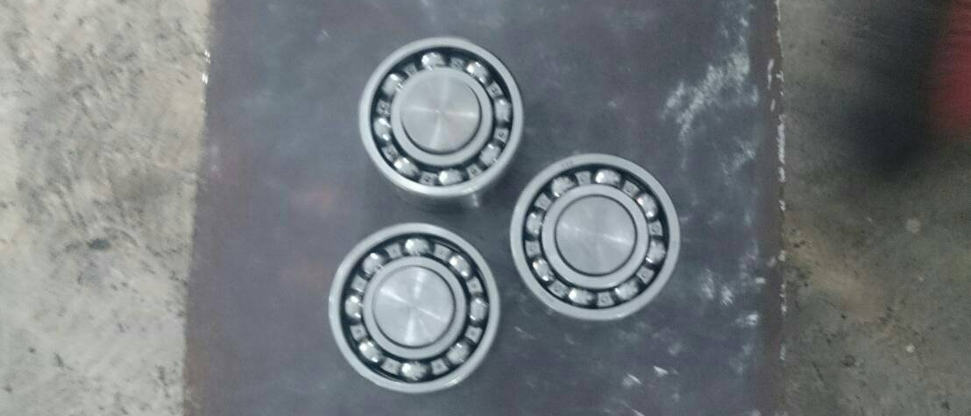
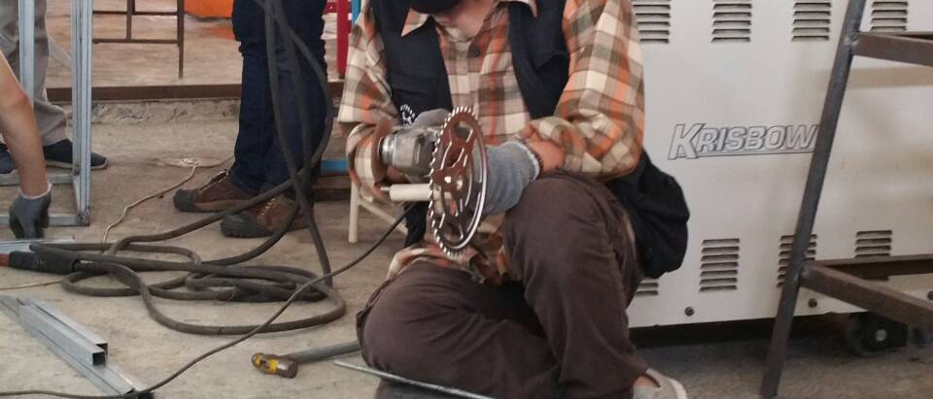
8th step
7th step
Weld the three shafts on the plate. And put two bearings by each shaft.
Weld the lever on the bearings.

Slide 24
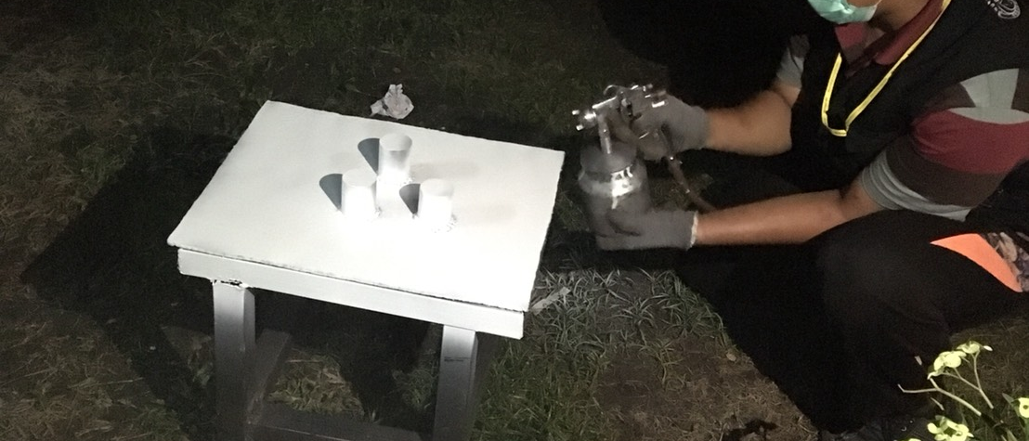
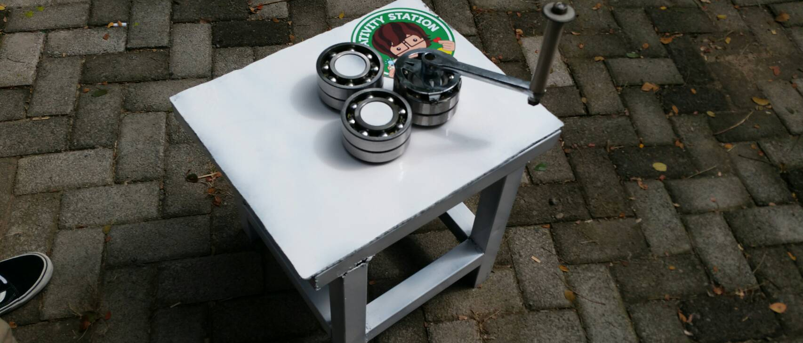
The Final Product
9th step
Polish the product with an anti-oxidant. And then, paint it as a white color with a compressor

Slide 25
How To Use
CREATIVITY STATION 2018

Slide 26
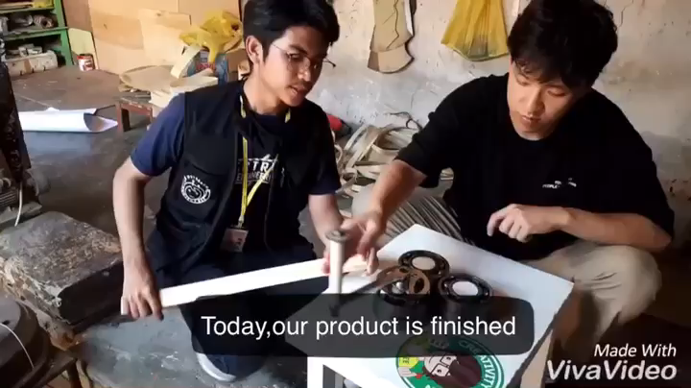

Slide 27
How To Maintain
CREATIVITY STATION 2018

Slide 28
How to maintain
Roller Machine
Put the product safely from rain
Coating the product with an anti-oxidant regulary

Slide 29
Result
CREATIVITY STATION 2018

Slide 30
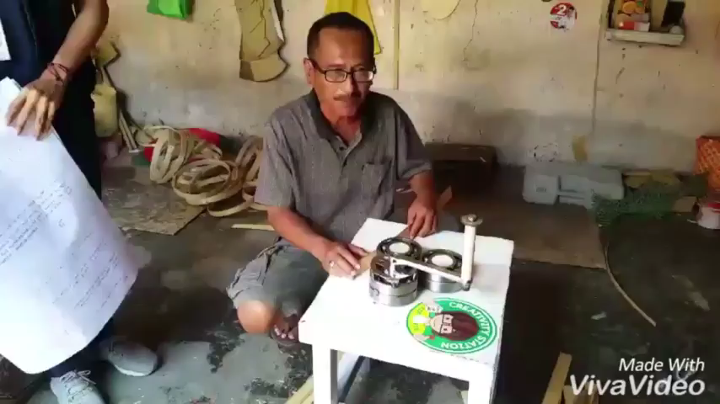
The result will be here

Slide 31
Thank You!
Any Questions?

